Slide 1

Estimating Household’s Physical Parameters Using Neural Ordinary Differential Equations
Davud Topalović and Dušan Gabrijelčič
Jožef Stefan Institute

Slide 2
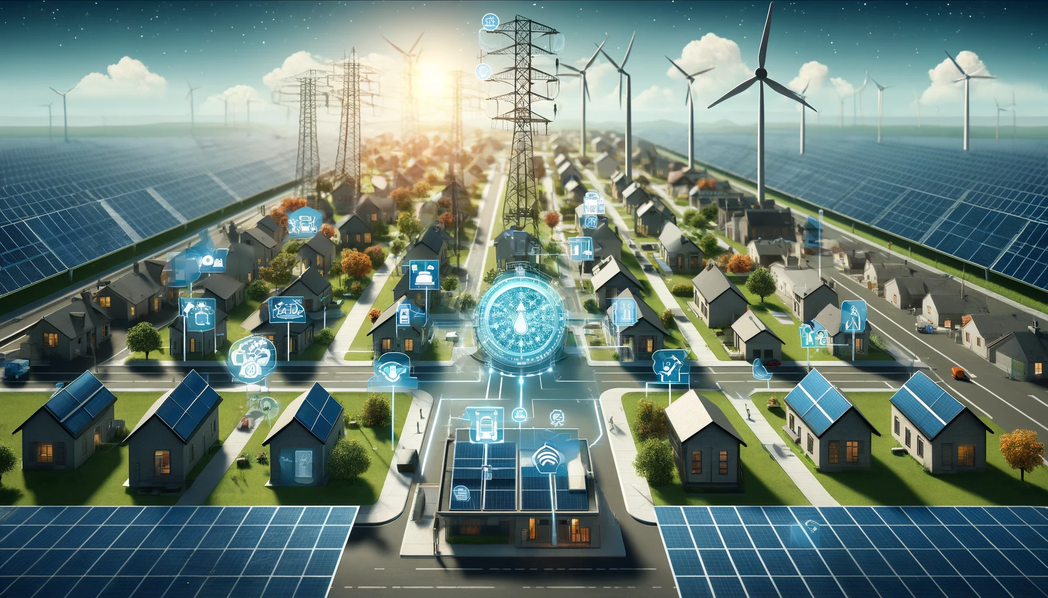
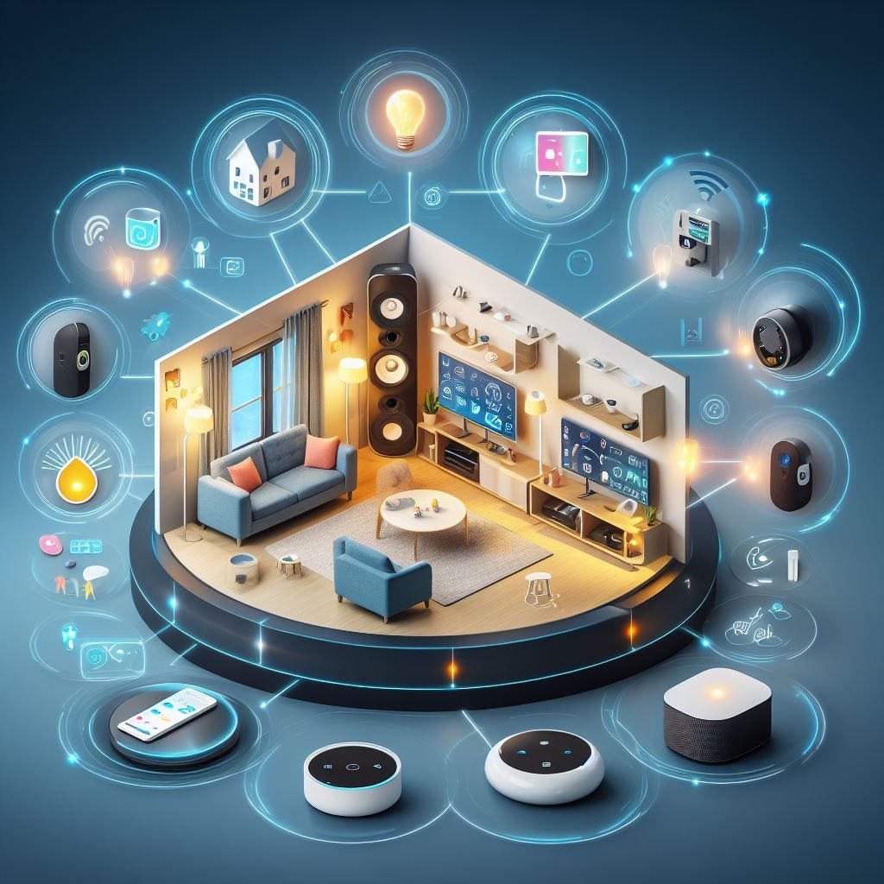
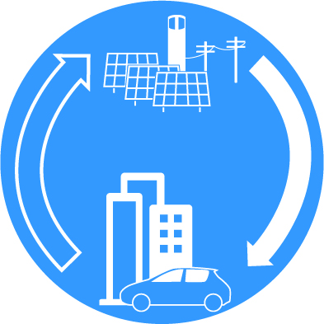
Motivation
The integration of renewable energy sources into the power grid presents unique challenges due to the varying nature of power generation and the decentralization of energy sources.
Grid stability and efficient energy consumption is crucial.
DEMAND-SIDE FLEXIBILITY – controlling the electricity usage by consumers and prosumers to improve efficiency.

Slide 3
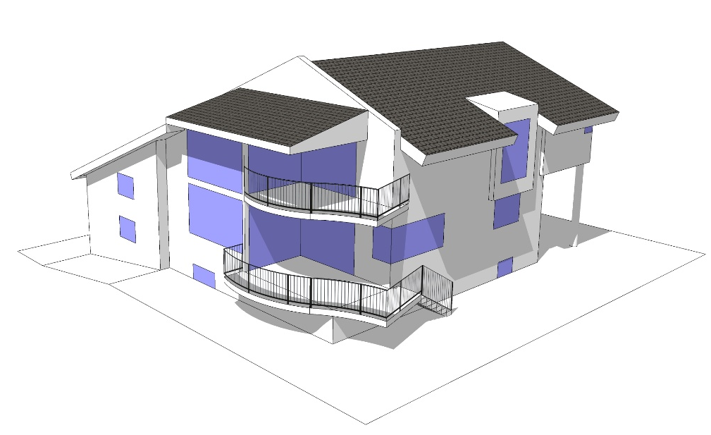
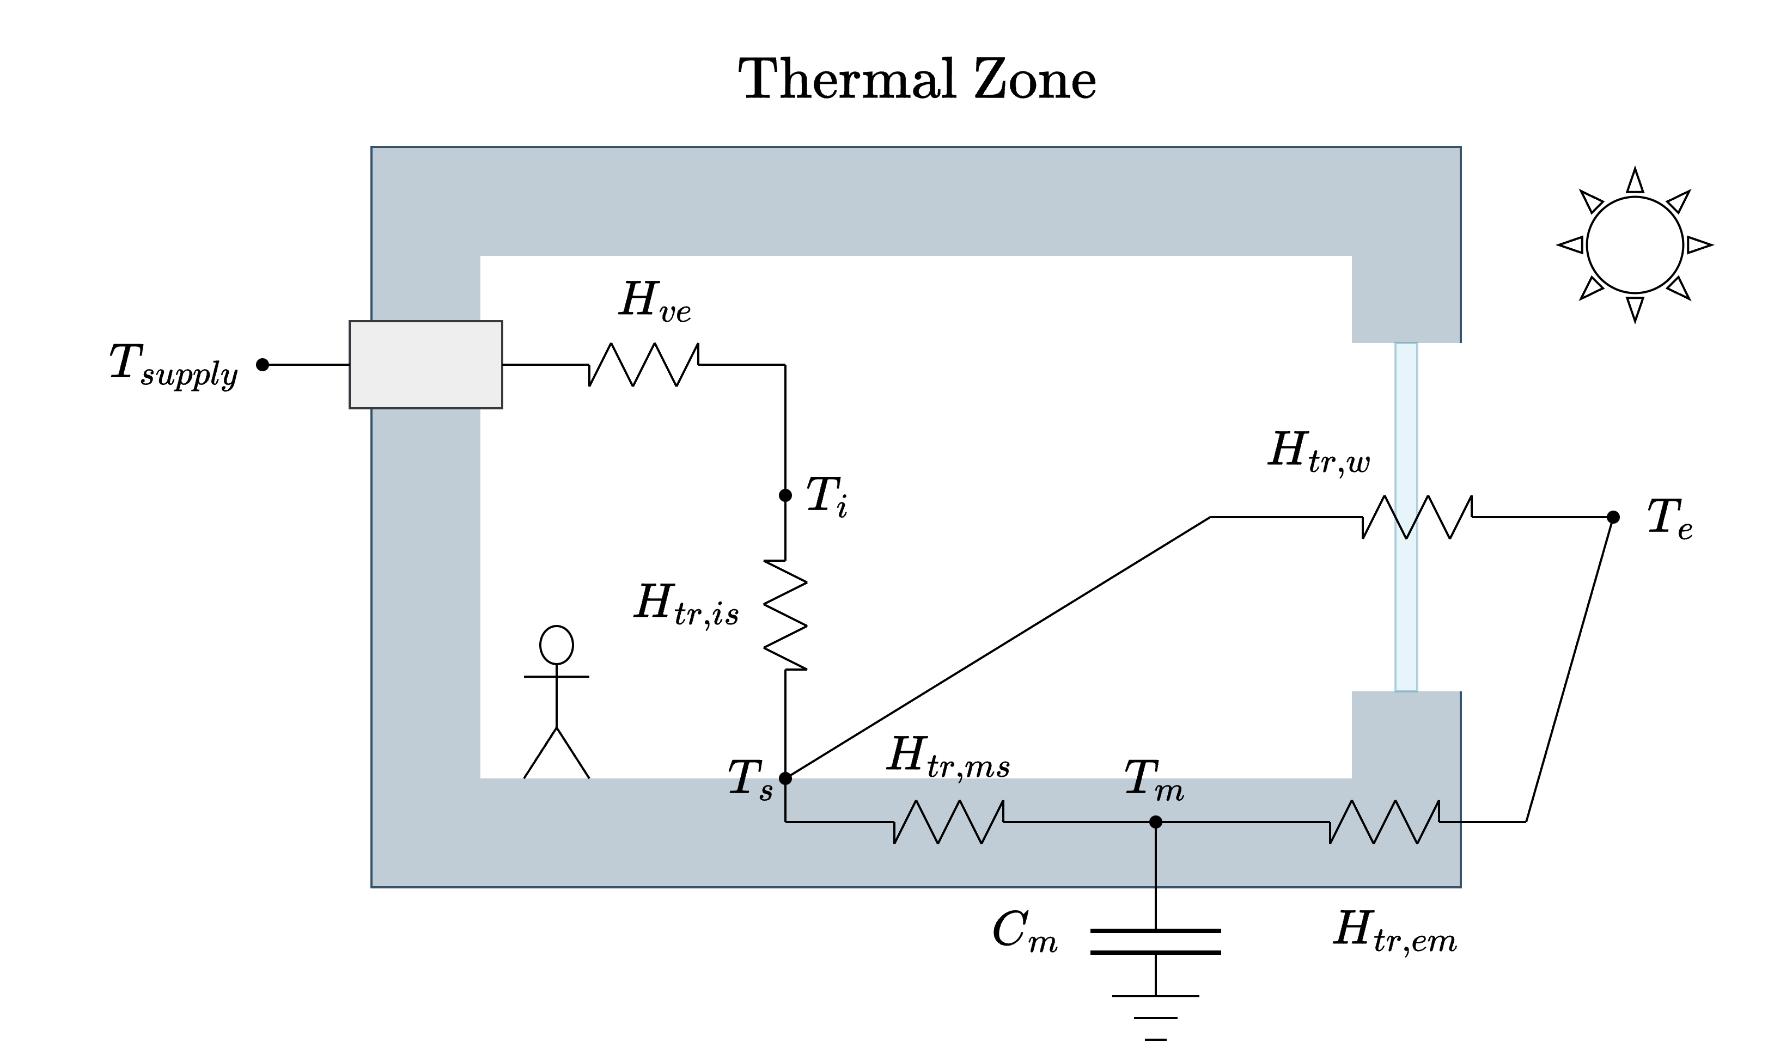
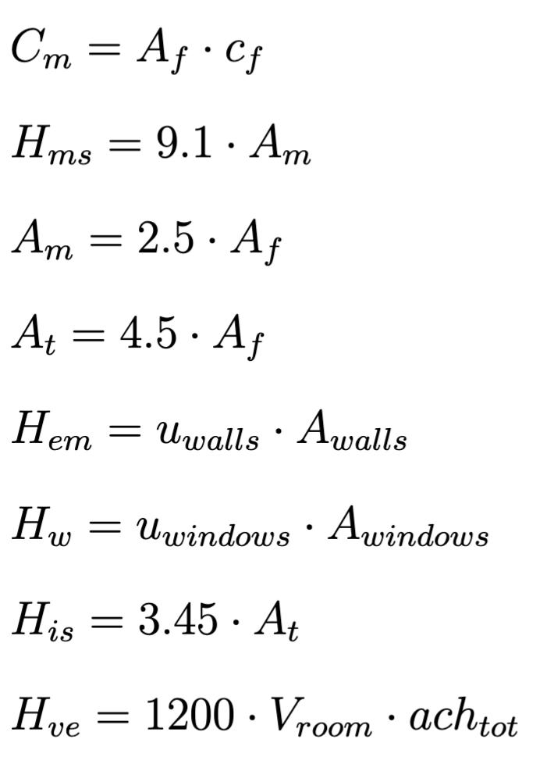
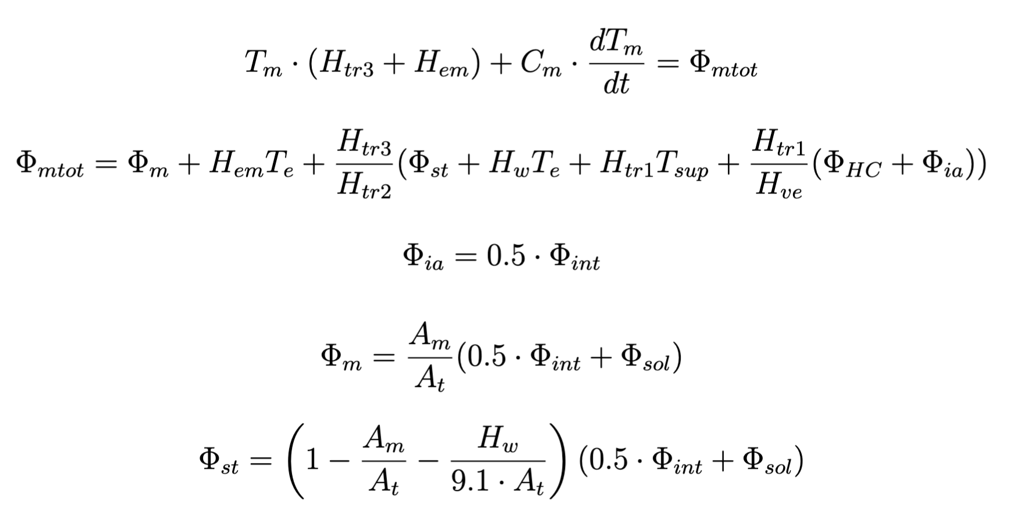
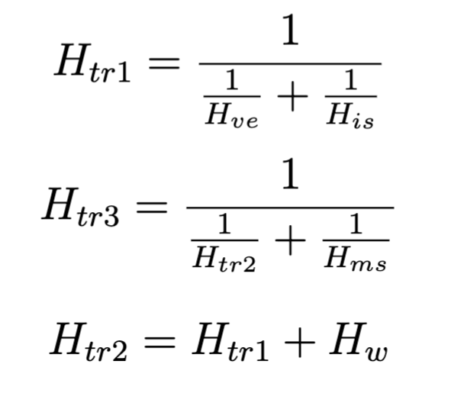
Motivation
5R1C thermal model, EN ISO 13790
Building – significant DSF potential
Thermal mass
&
HVAC system

Slide 4
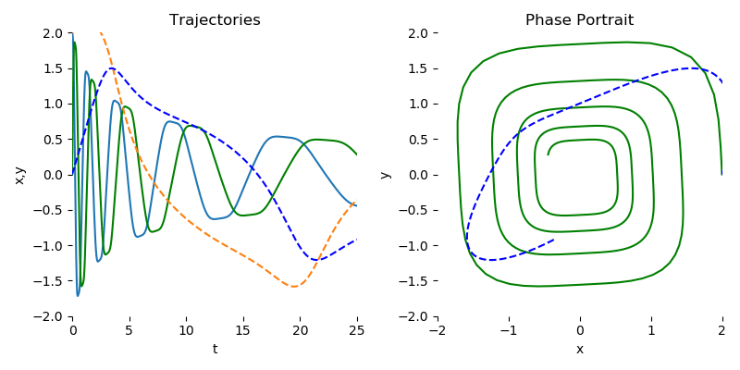
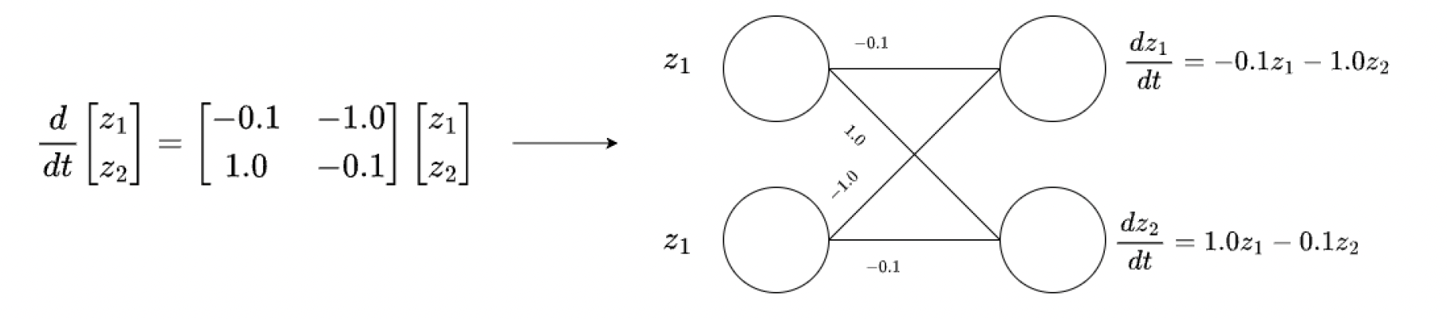
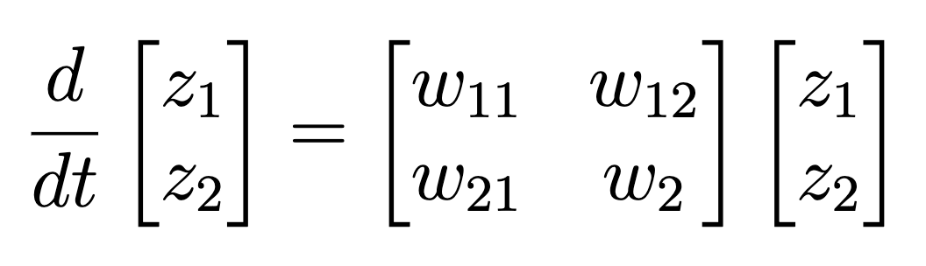
Neural Ordinary Differential Equations
powerful deep algorithm that utilizes Neural Networks for inferring the dynamics of the system.
https://github.com/rtqichen/torchdiffeq

Slide 5
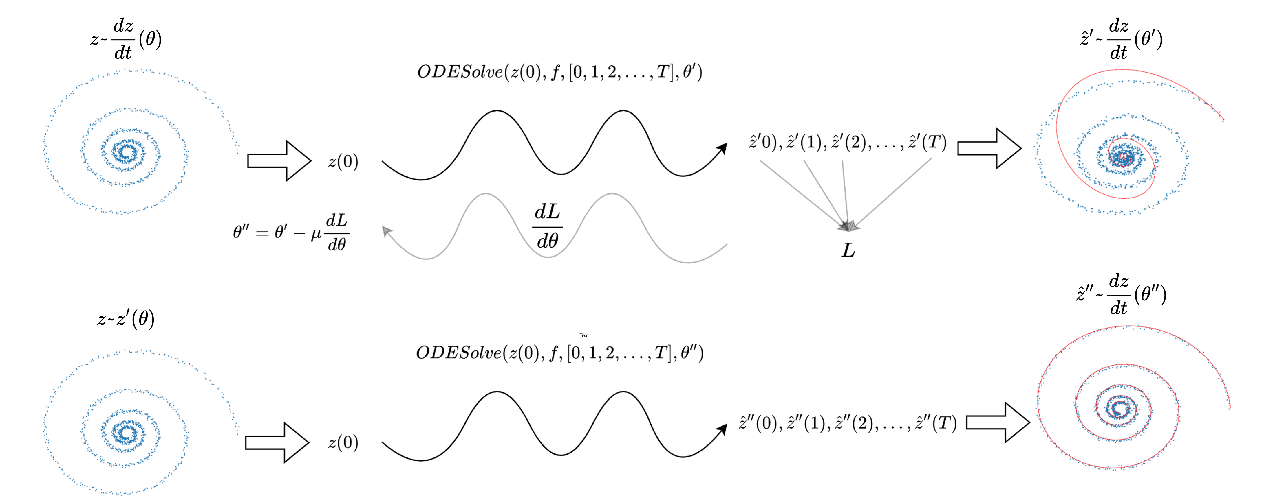
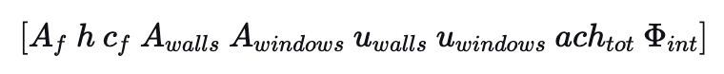
Neural Ordinary Differential Equations

Slide 6
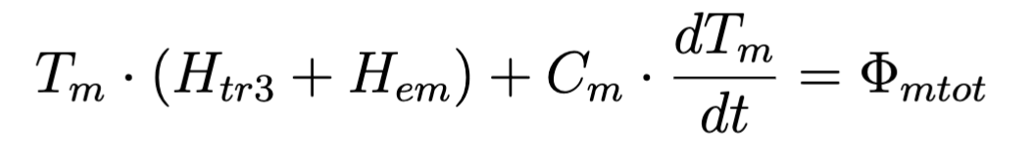
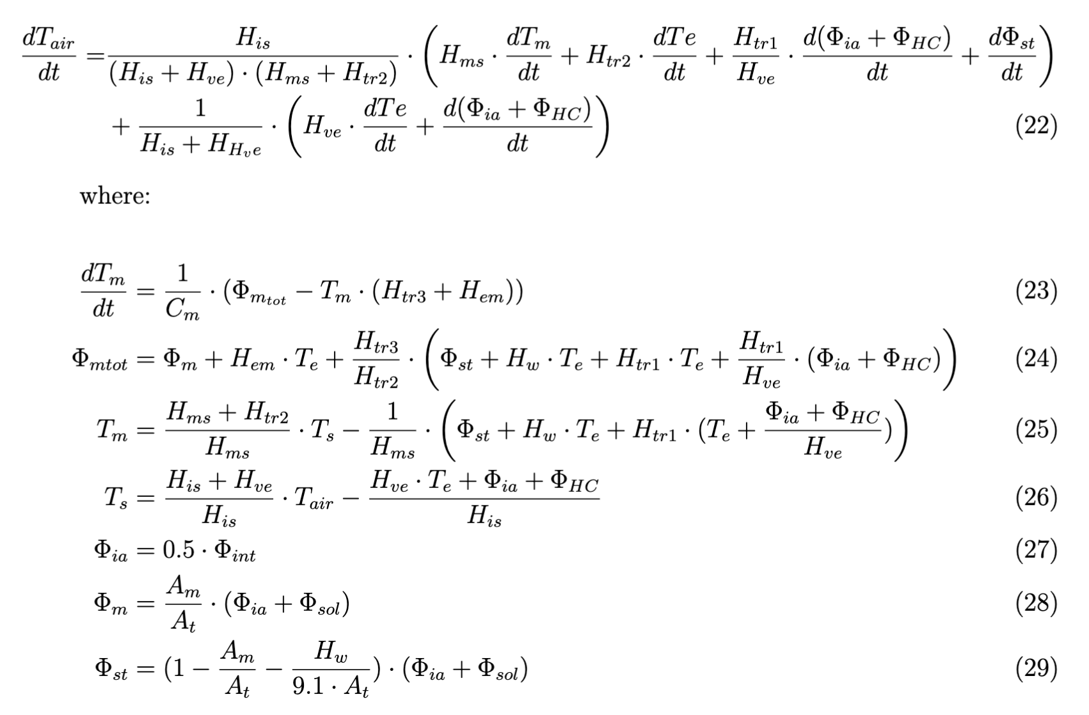
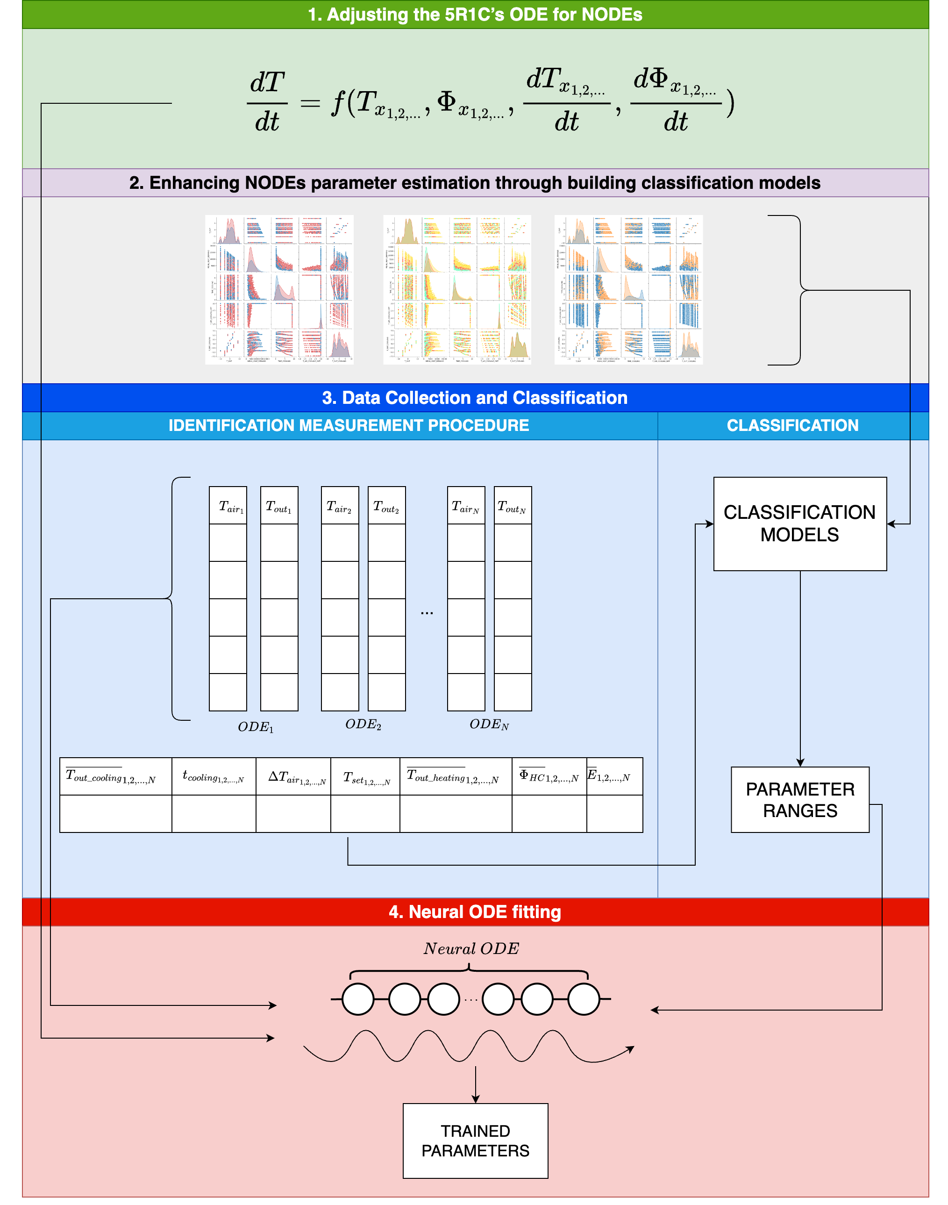
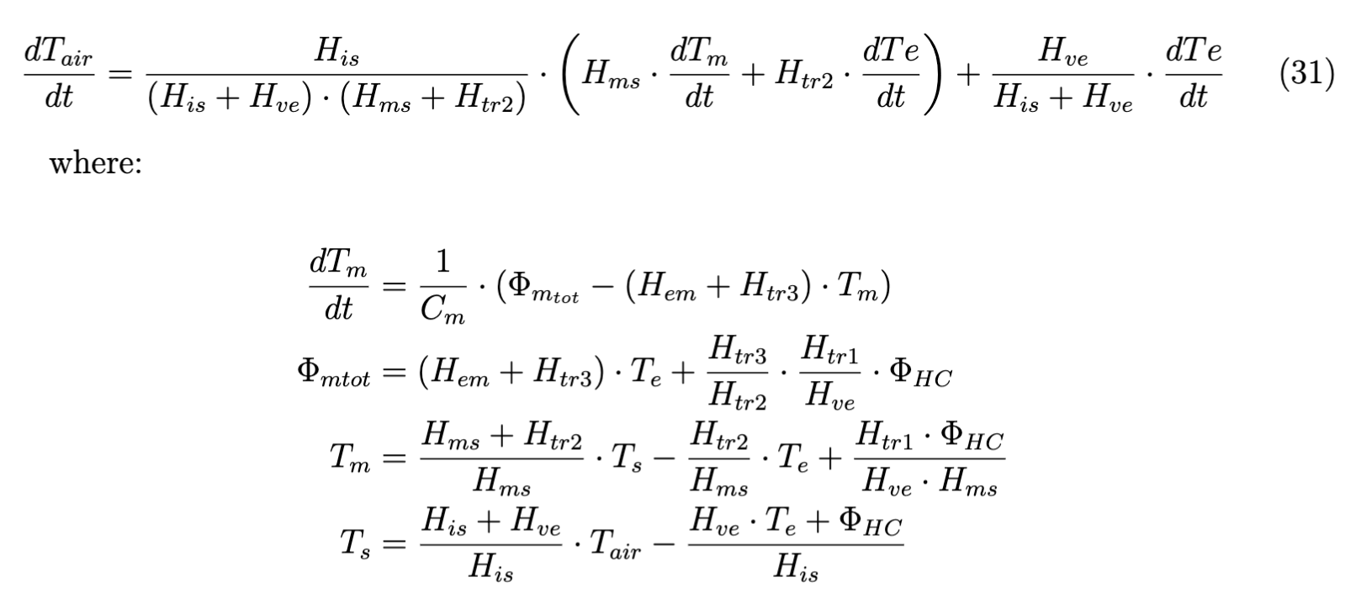
Methodology
night-time case___________________________________________________

Slide 7
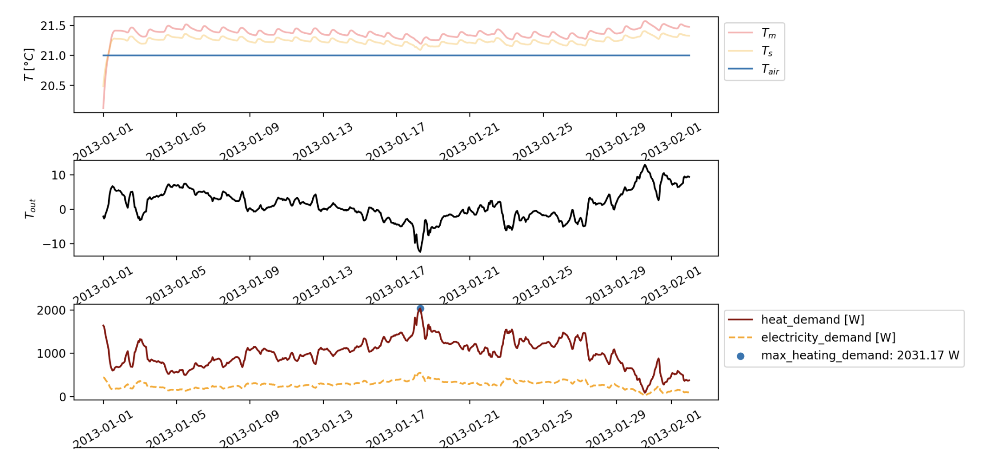
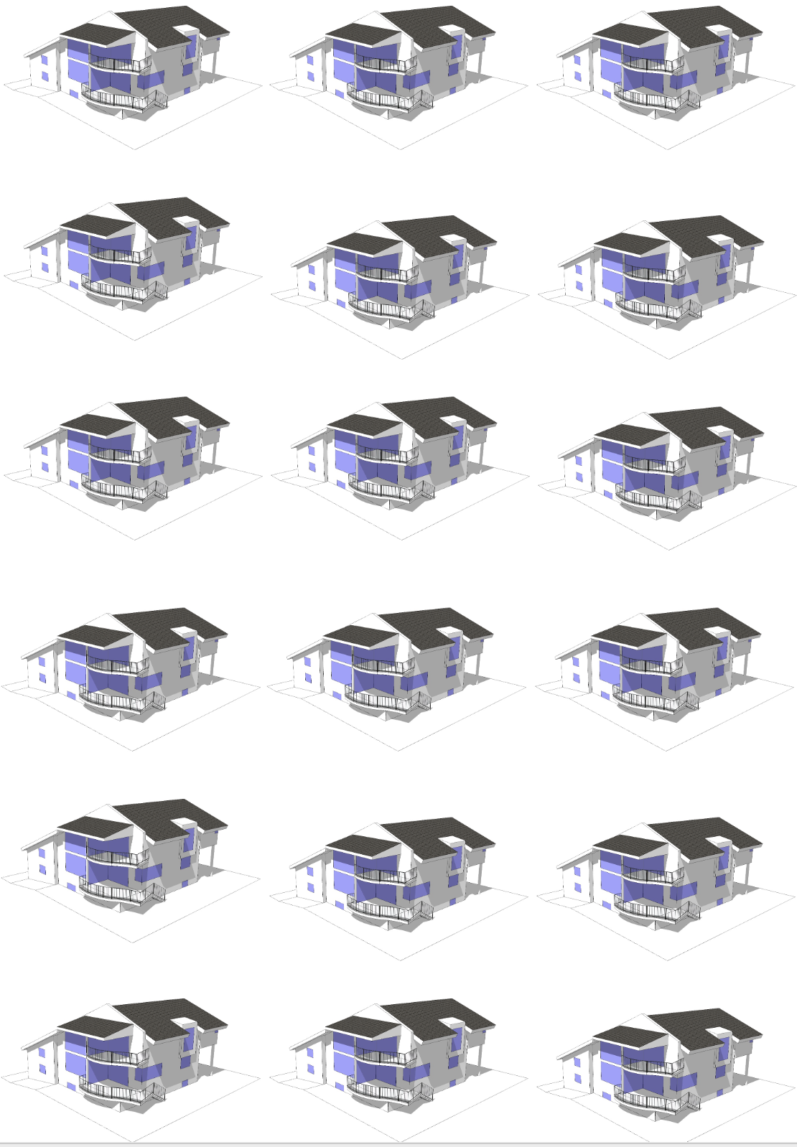
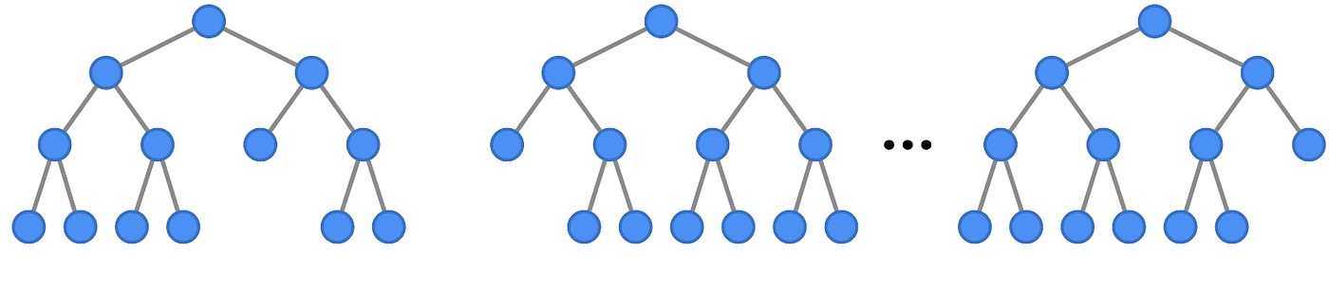
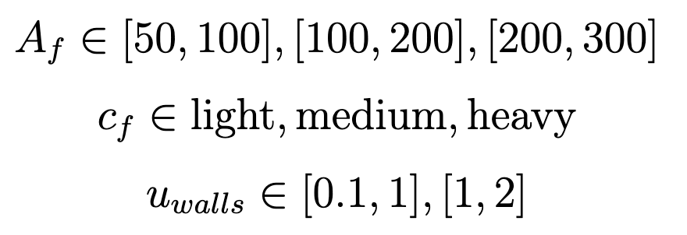
Methodology
BUILDING CLASSIFICATION MODELS with synthetic dataset
Predict the range for individual parameters and use them as constraints.

Slide 8
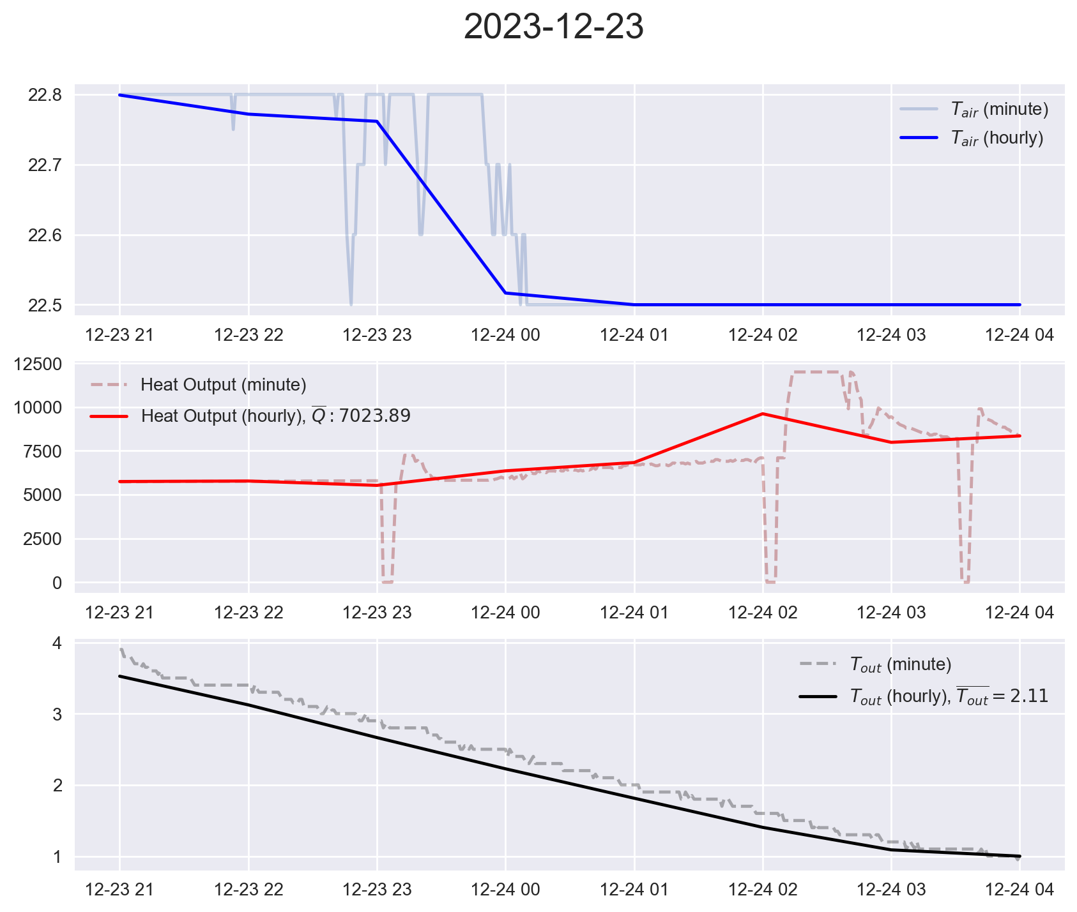
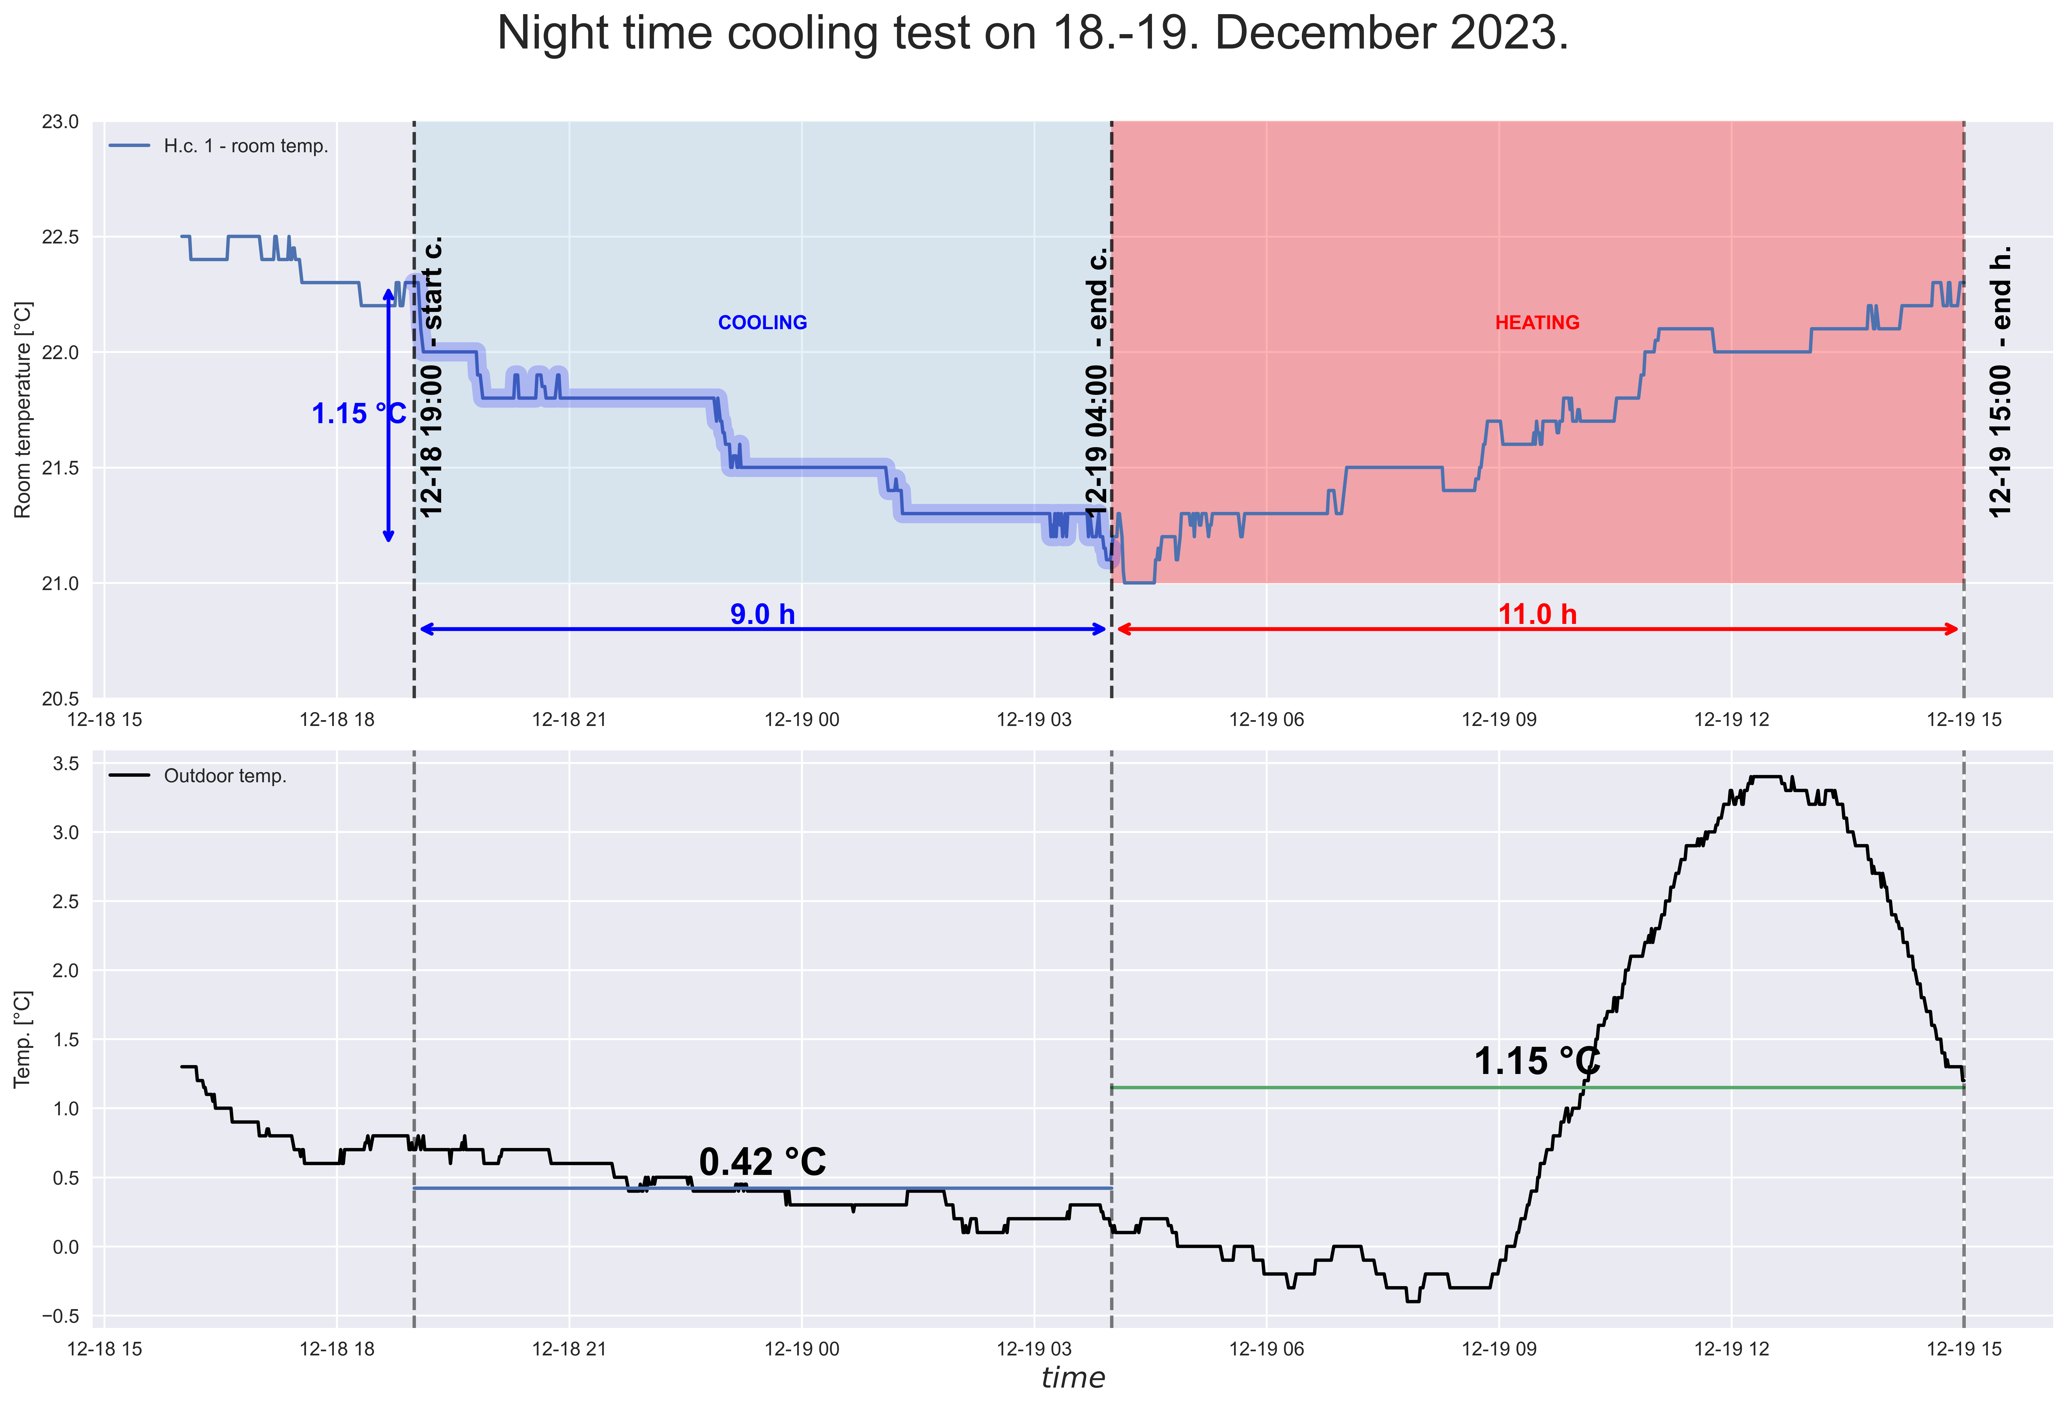
Methodology
Data collection – Identification Measurement Procedure
Normal operation night
Constrained heating night
PARAMETER RANGES

Slide 9
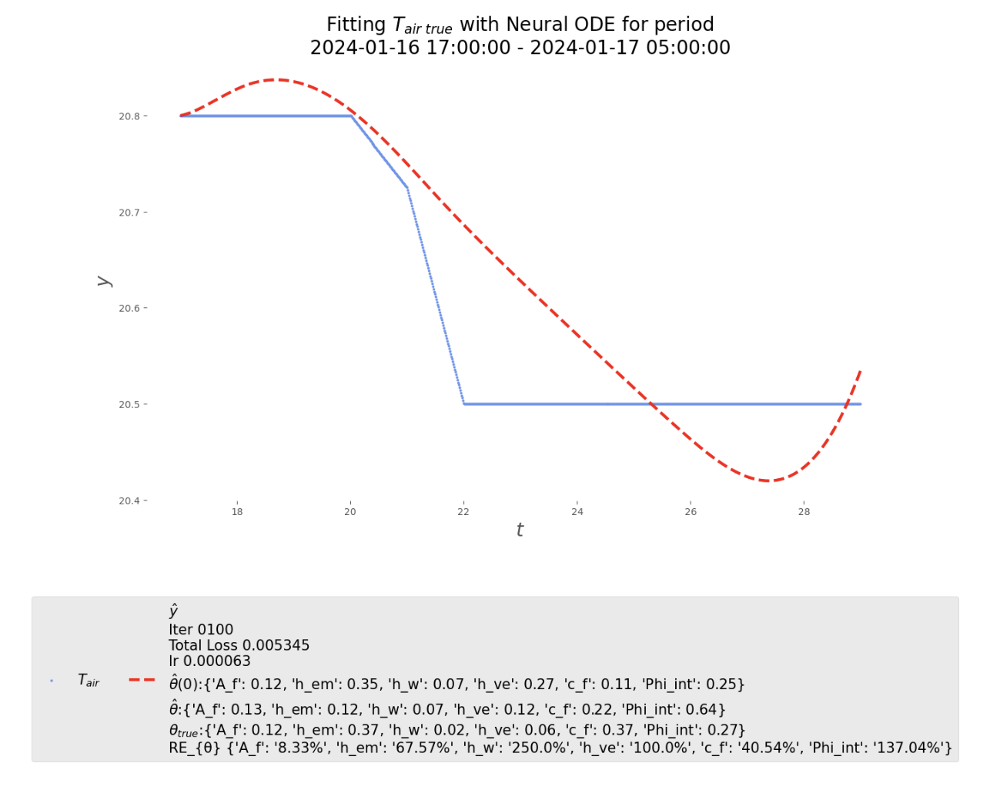
Methodology
Neural ODE training

Slide 10
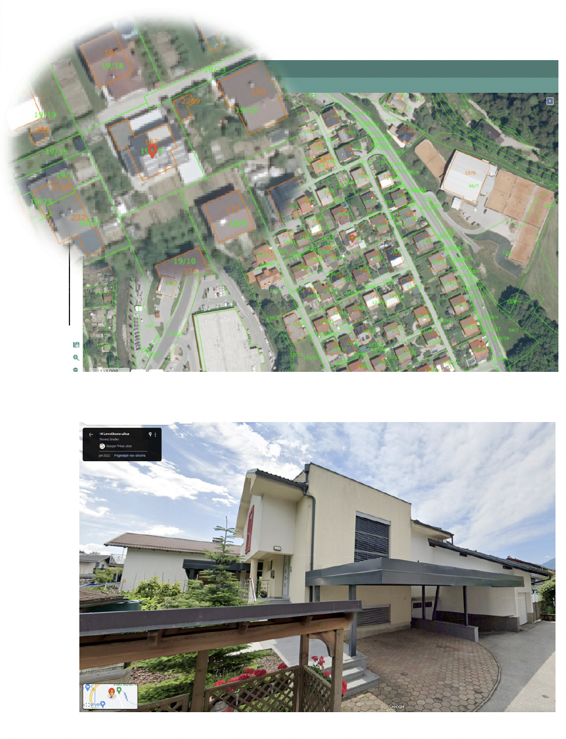
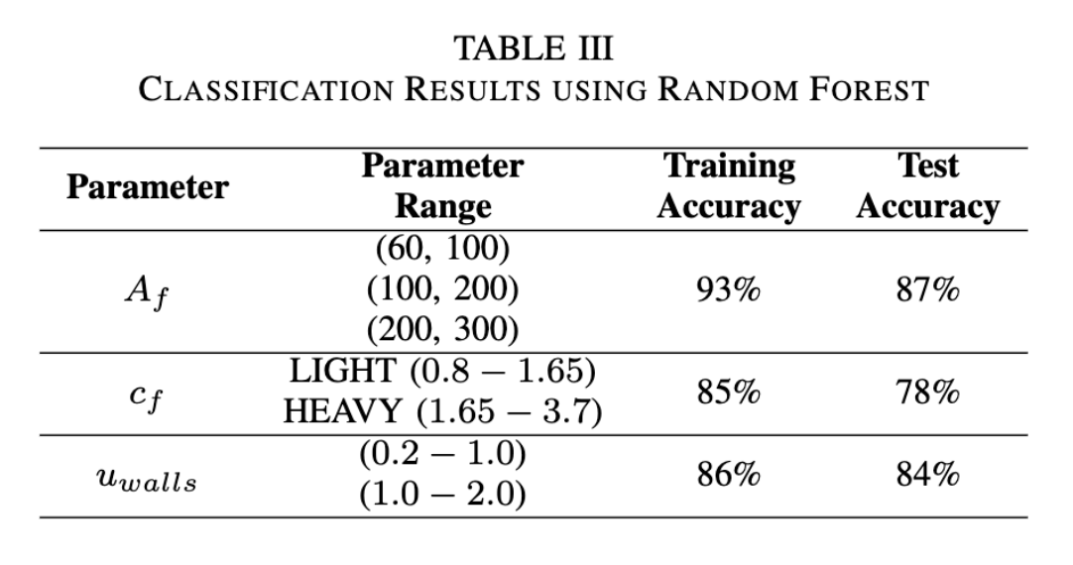
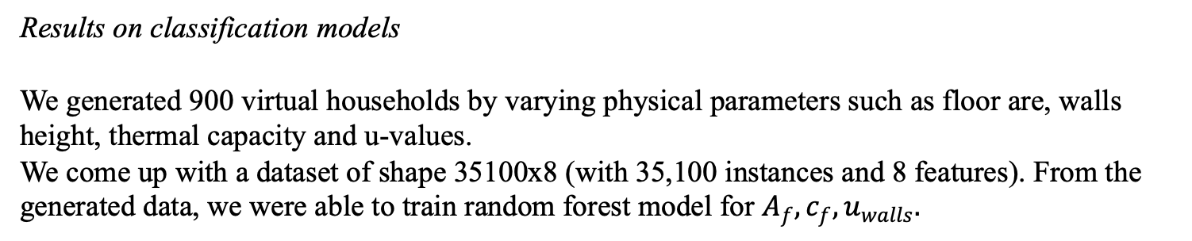
Case Study – results
Results on classification models
We generated 900 virtual households by varying physical parameters such as floor are, walls height, thermal capacity and u-values. We come up with a dataset of shape 35100x8 (with 35,100 instances and 8 features). From the generated data, we were able to train random forest model for $A_{f}, c_{f}, u_{walls}.$

Slide 11
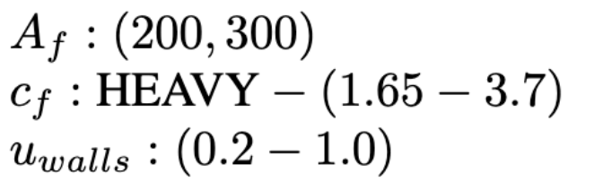
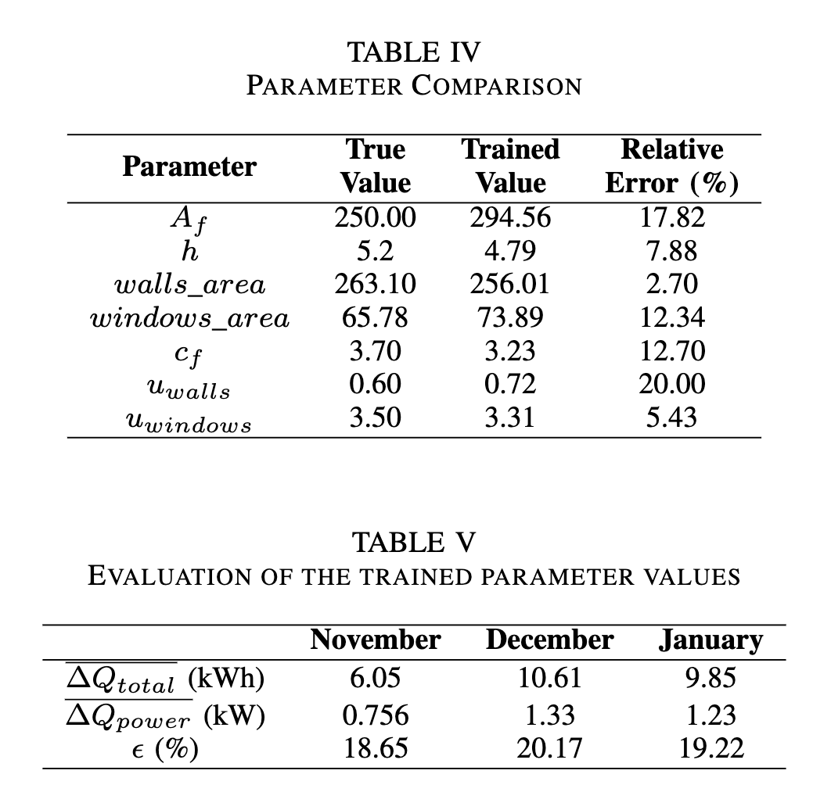

Case Study – results
Data collection and Classification
IMP procedure - conducted in December, 2023 and January, 2024.
Constrained heating operation was performed twice and normal operation nights were taken only from January.
https://www.eutrip.si

Slide 12
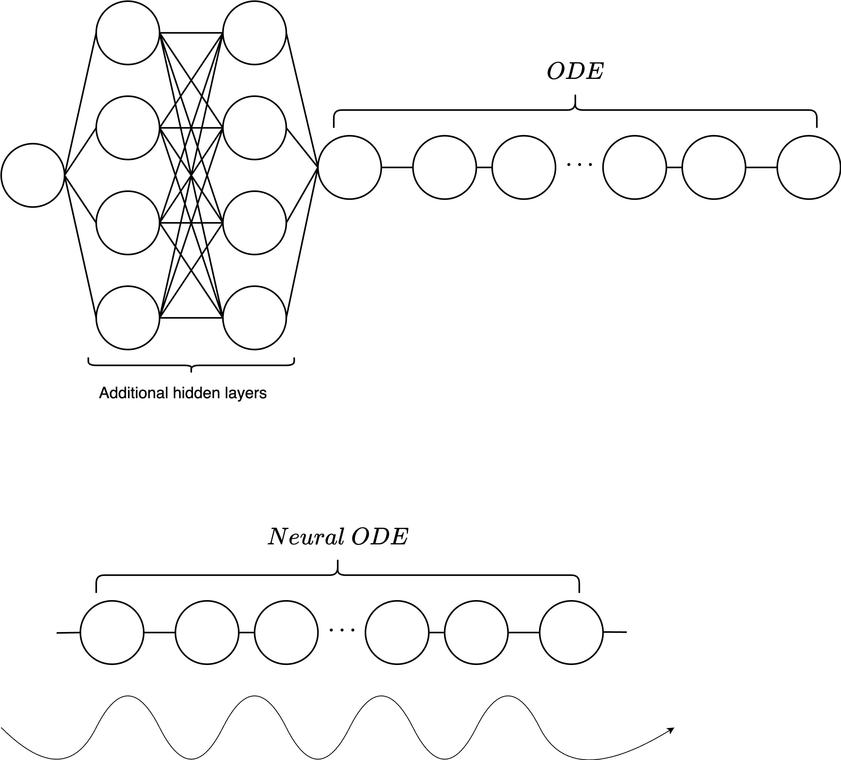
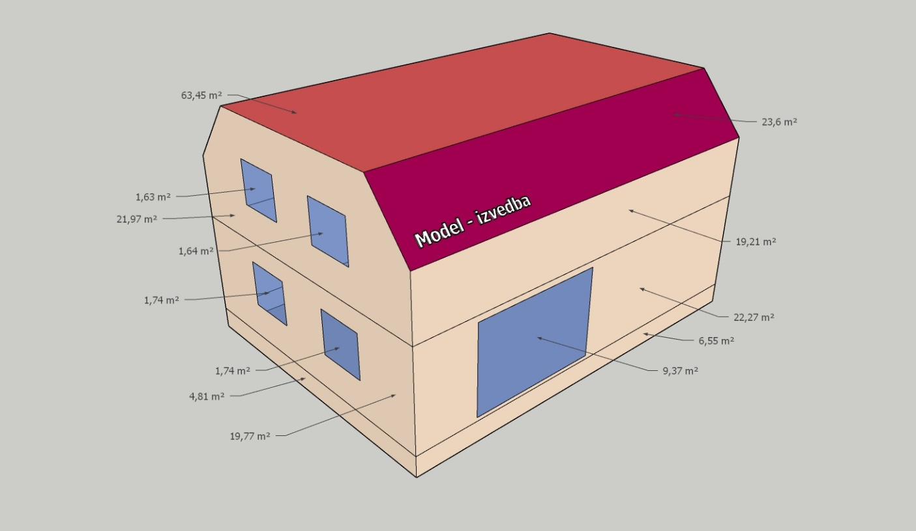
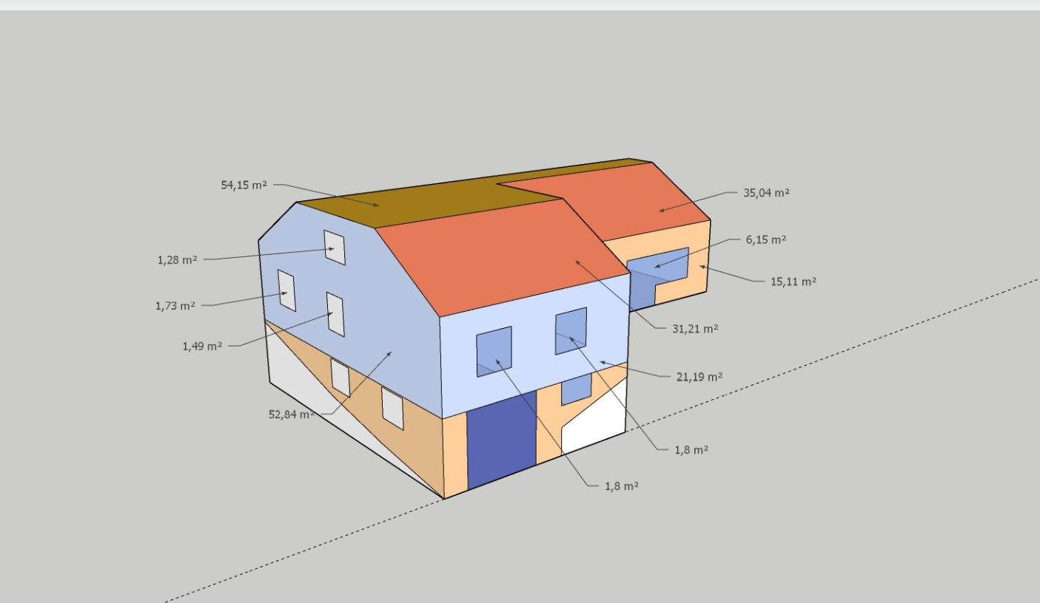
Future work
1. Experiment with more complex architectures
2. Apply the solution on multiple households and refine the solution
Include hidden layers that will not disturb the
underlying physics of the system.
3. Include internal gains, solar gains and air ventilation

Slide 13
Thank you ☺
Questions?

